Slide 1

Road to Ruby for A Linguistics Nerd
Composed By: Hayato Ishida
For Japanese version, click here
Updated On: 15 May 2025

Slide 2

About Me
Accounts
GitHub: @hayat01sh1da
X: @hayat01sh1da
LinkedIn: @hayat01sh1da
Speaker Deck: @hayat01sh1da
Docswell: @hayat01sh1da
Occupation: Software Engineer
Things I Am Into
Linguistics
Singing at Karaoke
Listening to Music
Watching Movies
Cat Feeding

Slide 3
Licences / Certifications
English
TOEIC® Listening & Reading 915: Certified on December 2019
Engineering
Information Security Management: Certified on November 2017
Applied Information Technology Engineer: Certified on June 2017
Fundamental Information Technology Engineer: Certified on November 2016
IT Passport: Certified on April 2016
Others
Abacus 2nd Class: Certified on June 2002
Mental Arithmetic 3rd Class: Certified on February 2001

Slide 4
Skill Stack
Languages
Japanese: Native Proficiency
English: Full professional Proficiency
Development
Backend: Ruby(Ruby on Rails), Python
Frontend: TypeScript + React.js, TypeScript +Vue.js
Database: MySQL, PostgreSQL, MongoDB
Architecture: Monolith, Modular Monolith
Hosting: AWS ESK
Versioning: Git, GitHub
CI/CD: GitHub Actions, ArgoCD
Monitoring: Datadog, Sentry

Slide 5
Work Histories
Period | Genre | Position | Jobs
Aug 2021 - Present | Saas(Educational Service) | Software Engineer | Backend Development Frontend Development CI/CD Maintenance Weekly Release Manager Troubleshooting Documentation Technical Debt Resolution Tech Blog Entries LT Speaker
Feb 2020 - Dec 2020 | SaaS(Chatbot Platform) | Backend Engineer | Backend Development Documentation Technical Debt Resolution Inspection of Alternative API

Slide 6
Work Histories
Period | Genre | Position | Jobs
Jun 2018 - Jan 2020 | Contract-basis Developer | Software Engineer | Backend Development Frontend Development Troubleshooting Quality Assurance Tech Blog Entries
Apr 2016 - Jan 2018 | System Engineering Service | System Engineer | Corporate Account Admin Windows Server Maintenance Security Admin Assistant Internationalisation / Localisation

Slide 7
International-Exchange Activities
Activities in University
English Linguistics Seminar(Focusing on Mass Media English)
International-Exchange Clubs(The 2nd Year)
International-Exchange Programmes conducted by Japan Cabinet Office(2013 - 2016)
Japanese Linguistics Course(The Final Year)
Overseas Life Experience
Working Holiday in Australia(April 2014 - March 2015)
Language School for 1 month in Sydney
Work for 6 Months in Hamilton Island Resort
Volunteering for 1 Month as Assistant Teacher of Japanese Language at St Ives High School in NSW
Other Activities
Keep Everyday Journal in English (April 2014 - Present)
Sunrise Toastmasters Club(February 2017 - March 2018)
Vital Japan(January 2018 - July 2019, October 2022 - February 2023)
Self Learning and Training of English Language
Participation Ruby-Related Tech Conferences

Slide 8
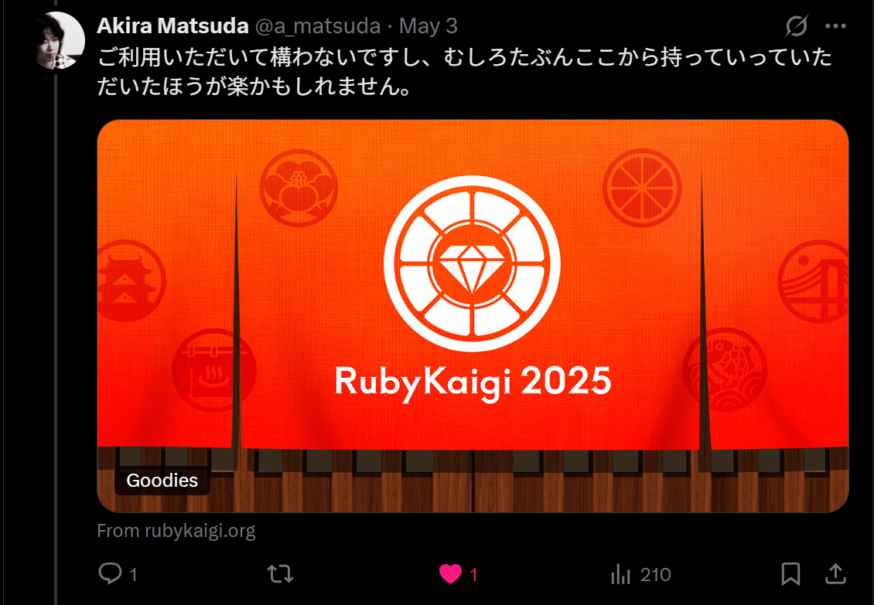
Prior to Lightening Talk…
The chief organiser of RubyKaigi, Mr. Akira Matsuda, allows me to use the official logo of RubyKaigi 2025 as the background image. No offence to its copyright.
Ref) https://x.com/a_matsuda/status/1918612709169672210

Slide 9
Agenda
My Goal in RubyKaigi 2025
KaigiEffect -A Field I Have Been Into-
The Most Memorable Discussion Mr. Matz
As Is vs. To Be
References

Slide 10
1. My Goal in RubyKaigi 2025

Slide 11
1. My Goal in RubyKaigi 2025
To Find A Breakthrough where
I Can Contribute to Ruby
as A Linguistics Nerd.

Slide 12
1. My Goal in RubyKaigi 2025
What brought me this goal?
Have a long development experience in Ruby, but turned away from understanding of its complicated and profound lower layers
The fact made me an immature developer who can use Ruby but cannot make the most of Ruby
Strongly realised it was high time to seriously face and learn the ecosystem and lifecycle on lower layers of Ruby
Wondered what I should cut my teeth on, so I decided to find something linguistic which may bring me a huge interest at RubyKaigi 2025

Slide 13
1. My Goal in RubyKaigi 2025
What strategies did I take?
Picked up only the speeches focusing on the field I was interested in
Took notes of keywords which did not make sense and/or attracted me, instead of trying to understand all
Started learning the details of the keywords after RubyKaigi 2025 was over

Slide 14
2. KaigiEffect -A Field I Have Been Into-

Slide 15
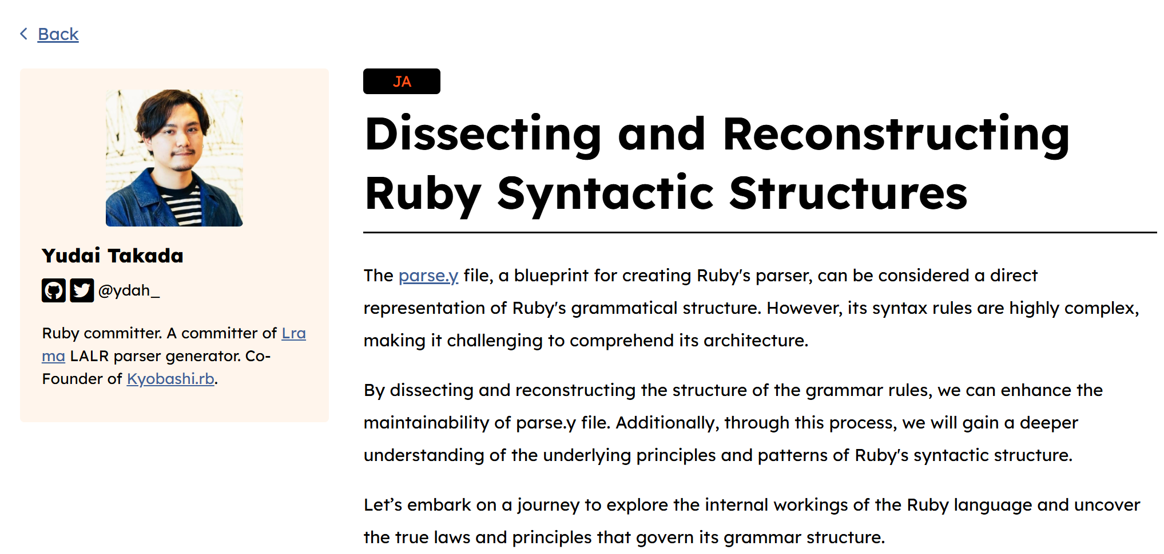
2. KaigiEffect -A Field I Have Been Into-
A Big Interest in Language Processing Ecosystem and Lifecycle
Used not to be interested in parser without any special reasons till this year
Dissecting and Reconstructing Ruby Syntactic Structures presented by @ydah_ san brought me a huge interested in how Ruby source codes are interpreted

Slide 16
2. KaigiEffect -A Field I Have Been Into-
Discussion with My Colleagues and Collection of Materials
Turned out the ecosystem was more complex than I knew
Would love to know more about details of Ruby language processing system
Discussed what materials are useful to learn Ruby language processing system works with my coworkers who are deeply familiar with the field
Bookmarked the recommended websites and files
I got recommendations on X as well(My best regard to all kind Rubyists)
* Having knowledgeable colleagues is 100% absolutely AN EMPLOYEE WELFARE

Slide 17
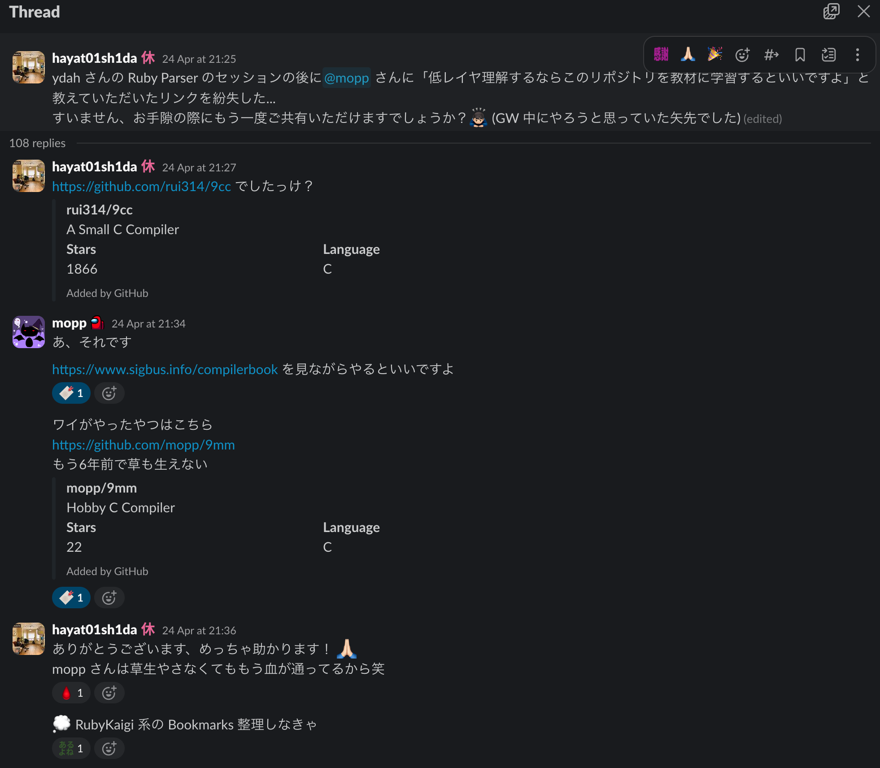
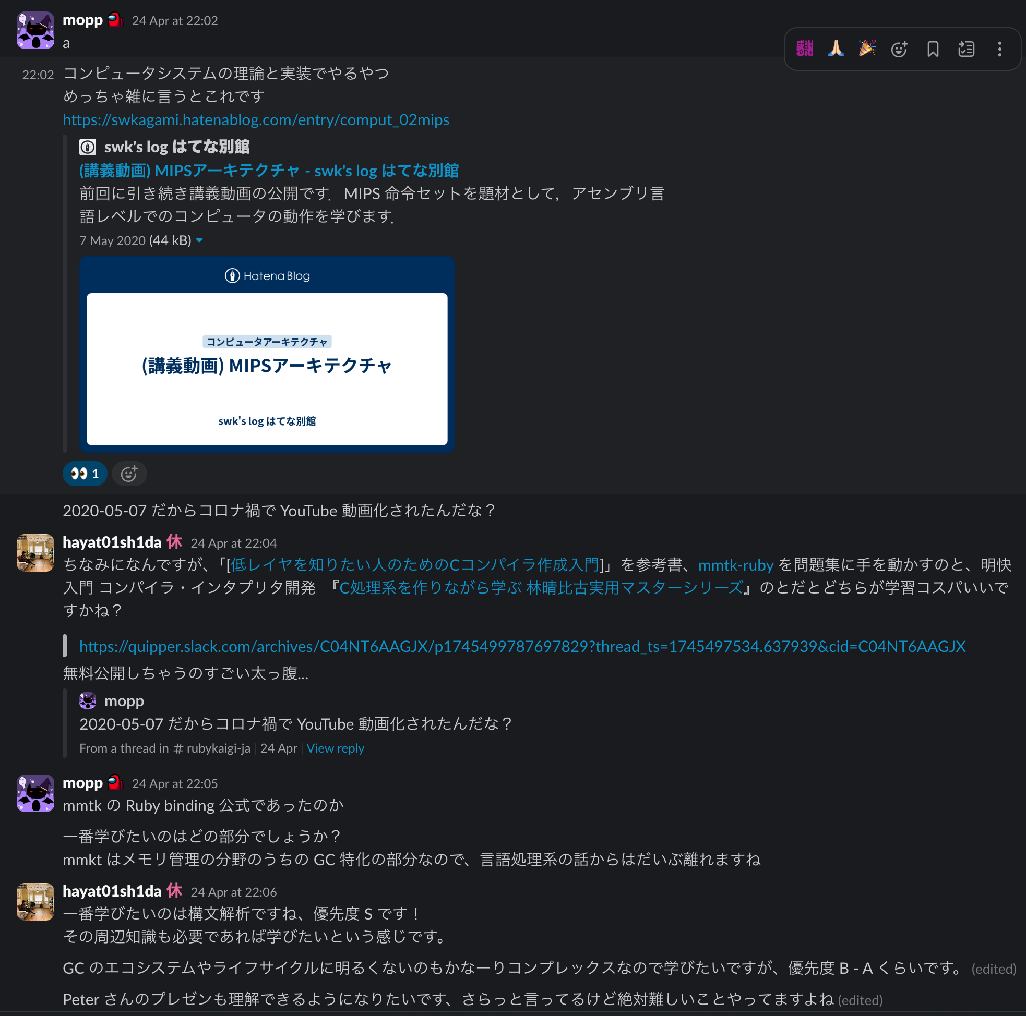
2. KaigiEffect -A Field I Have Been Into-
Discussion with My Colleagues and Collection of Materials

Slide 18
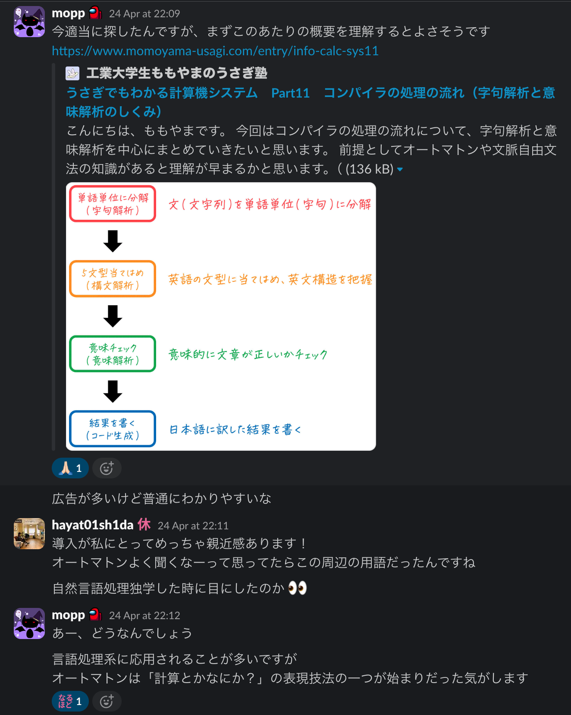
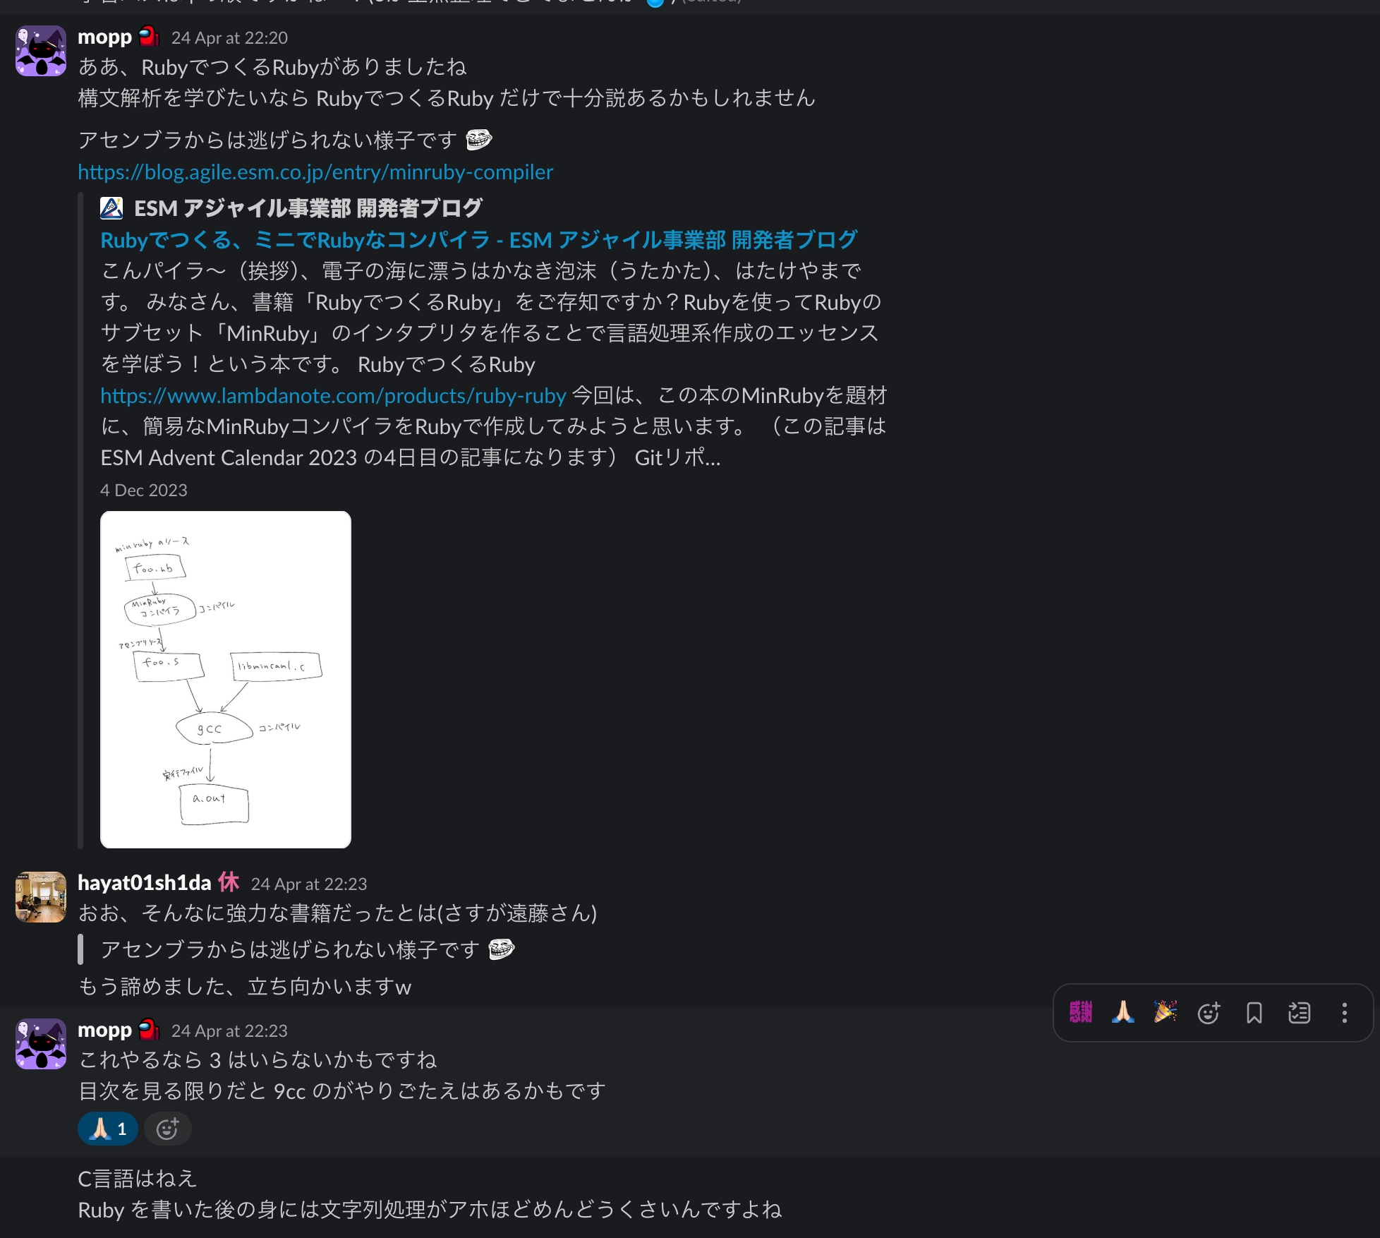
2. KaigiEffect -A Field I Have Been Into-
Discussion with My Colleagues and Collection of Materials

Slide 19
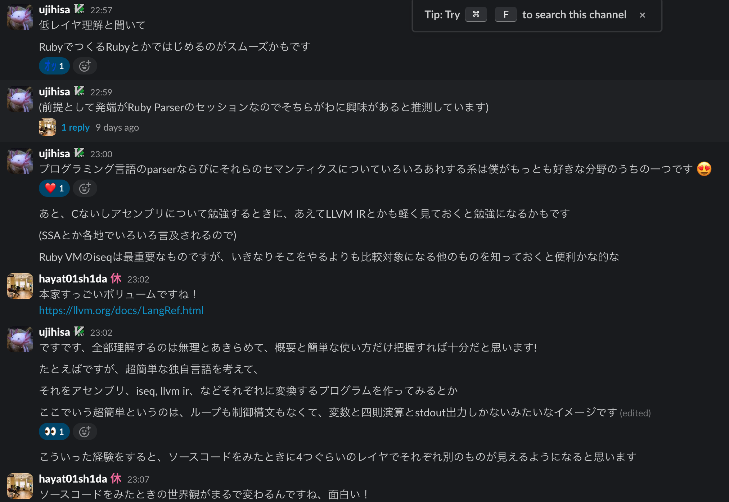
2. KaigiEffect -A Field I Have Been Into-
Discussion with My Colleagues and Collection of Materials

Slide 20
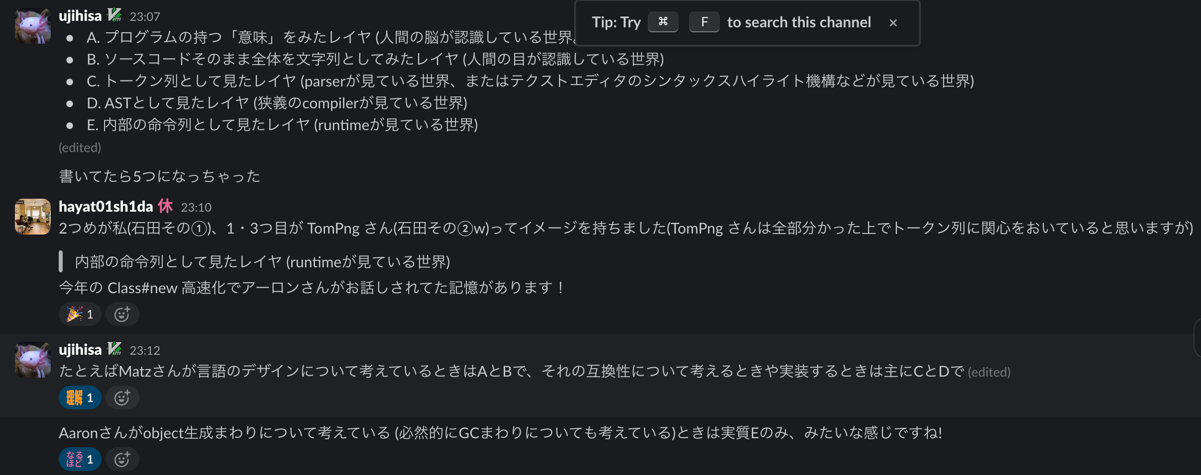
2. KaigiEffect -A Field I Have Been Into-
Discussion with My Colleagues and Collection of Materials

Slide 21
2. KaigiEffect -A Field I Have Been Into-
What am I learning by?
LLVM Language Reference Manual
Parsing Techniques
低レイヤを知りたい人のための C コンパイラ作成入門
MIPS アーキテクチャ
うさぎでもわかる計算機システム Part10 コンパイラの基礎・分割コンパイルの流れ
うさぎでもわかる計算機システム Part11コンパイラの処理の流れ(字句解析と意味解析のしくみ)
Ruby Parser 開発日誌(14) - LR parser 完全に理解した
オートマトンと言語理論 学習記 #1: オートマトンとは何か -
オートマトンと言語理論 学習記 #2: 有限オートマトン -
Ruby の中身の予備知識 RubyKaigi の前に知り鯛！
たのしい Ruby の構文解析ツアー
LL 法と LR 法の違いは？調べてみた！-完全版-/Comparing LL and LR parse algorithm -EX Edition-

Slide 22
2. KaigiEffect -A Field I Have Been Into-
What am I delivering by?
Ruby でつくる、ミニで Ruby なコンパイラ
9cc
lr-parser-101
『Ruby でつくる Ruby ゼロから学びなおすプログラミング言語入門』

Slide 23
2. KaigiEffect -A Field I Have Been Into-
Participation in A Brand-New Ruby Community
Shikumi.rb
organised by @hashimoto-kei and @utsubo
Born on May 2025 and still a new-born baby Ruby community
Sessions mainly held online
Focuses on language processing in Ruby, which is the very lifesaver for me.
Perfect attendance so far(as of 09 May 2025)

Slide 24
3. The Most Memorable Discussion Mr. Matz

Slide 25
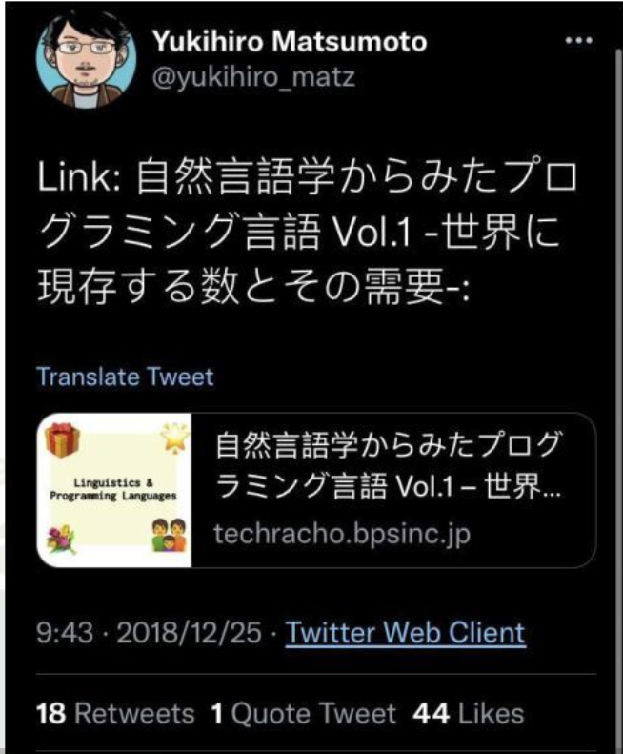
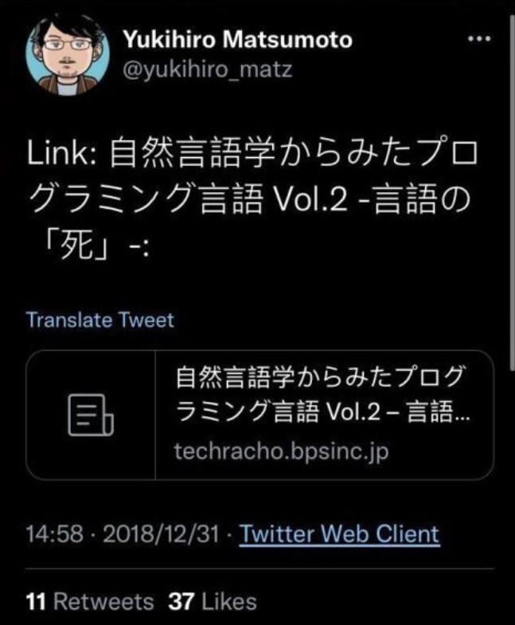
3. The Most Memorable Discussion Mr. Matz
I knew Mr. Matz was so interested in Linguistics that he shared my advent calendar entry on Twitter(Current. X) as mentioned in Life and Death -Natural Languages vs. Programming Languages-.
Also, I myself am sure that Ruby is highly conscious of as smooth a writing experience as English mentioned in Recommendation of Comparative Linguistics -Learn Identity of Programming Language from Ruby vs. Python-.

Slide 26
3. The Most Memorable Discussion Mr. Matz
Highly fortunately, I was on the same table as Mr. Matz had a seat on at Code Party RubyKaigi 2025 organised by ANDPAD and succeeded in having the following discussion.
* H = hayat01sh1da, M = Mr. Matz
H) Mr. Matz, you created Ruby learning from Perl, so it has some similarities to that. One of them is Linguistic and Cognitive Considerations. Did you have such a linguistic and cognitive philosophy when you created, grew and released Ruby?
M) Mr. Larry Wall, creator of Perl, has a backbone as a linguistics while I majored in Computer Science. Our backgrounds are different from those of each other, but I really value Linguistic and Cognitive Considerations taking care of compatibilities.

Slide 27
3. The Most Memorable Discussion Mr. Matz
H) As a Rubyist and someone who majored English linguistics, I believe that Ruby provides a smooth writing experience as English. I feel like writing Ruby is quite similar to writing an English poem. I do understand your philosophy and my hypophysis mentioned Recommendation of Comparative Linguistics -Learn Identity of Programming Language from Ruby vs. Python- is proved to be correct.
M) I think highly of not just how method works but what the method works for. For example, let's think about `Enumerable#collect` and `Enumerable#map`. Both of them returns a new array with the results of data processing of every element of the receiver, inside of the block. The former does it for data collection, whereas the latter for data mapping. As you see, this example demonstrates different methods of the same data processing have as many different purposes.
H) It reminds me what you mentioned in 107. The Importance of Naming on Japanese Edition of 97 Things Every Programmer Should Know as naming vividly reflects the design.

Slide 28
3. The Most Memorable Discussion Mr. Matz
M) In terms of naming, I made an error in the past. I thought about naming for a method which takes its receiver as the block argument of returns the result of processing it. At first, I named it `Object#yield_self`. It makes sense in order to describe how it works, but I failed to illustrate what it is for. Later on, I created its alias as `Object#then`. Data processing is done once prior to its receiver, and 'then' it focuses on what is done. It makes more sense not just in terms of the way the method works but the purpose the method works for.
H) Totally make sense. To compare it to English syntax, most of methods treat its receiver as the subject, themselves as the predicate verb, its argument(s) as the object(s) and inside of block as the subordinate clause(e.g. noun clause, adjective clause or adverb clause). However, you adopt an adverb 'then' as a method, which strikes me as incredibly impressive!

Slide 29
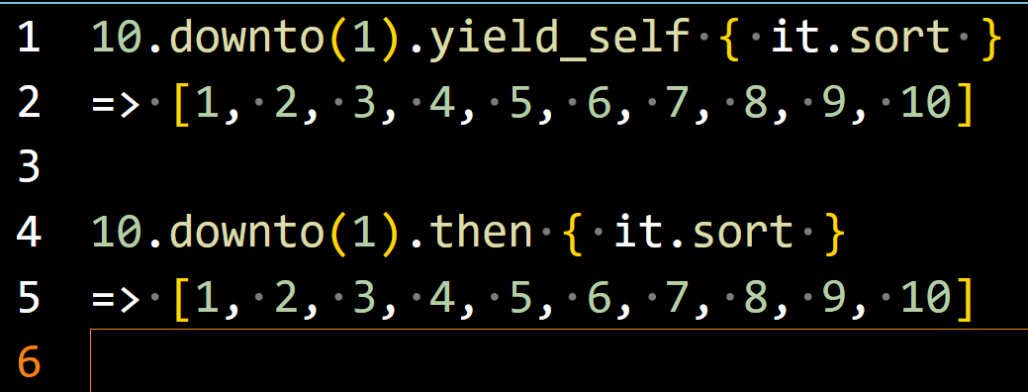
3. The Most Memorable Discussion Mr. Matz
Works as a phrasal verb
[
]
[
]
* Enumrable#sort returns a new array as the return value by rb_ary_sort_bang function through enum_sort function, so a Range object is implicitly converted to an Array object.
(
)
S = Subject
V = Verb
V1: SV
V2: SVC
V3: SVO
V4: SVO1O2
V5: SVOC
O = Object
O1: Indirect Object
O2: Direct Object
C = Complement
[Subordinate Clause]
(Modifier)
S
[S]
[V1]
V3
O
[S]
[V1]
(
)
(
)
S
V1
O
(and)
S
V1

Slide 30
3. The Most Memorable Discussion Mr. Matz
Object#yield_self vs. Object#then
Object#yield_self
Actually, yields its receiver as the following block argument
Does not describe how it is handled within the block by its name
The block works as a subordinate noun clause and has SV1 in it, which complex sentence with nested structure brings about higher cognitive load
Object#then
Literally works as and then (Coordinate Conjunction + Adverb)
Focuses on how the corresponding pronoun it is handled within the block
That is why, succeeds in describing how it, the referrer of the first principal clause, is handled within the block by its name
The block works as another principal clause, which simple sentence without nested structure provides better readability

Slide 31
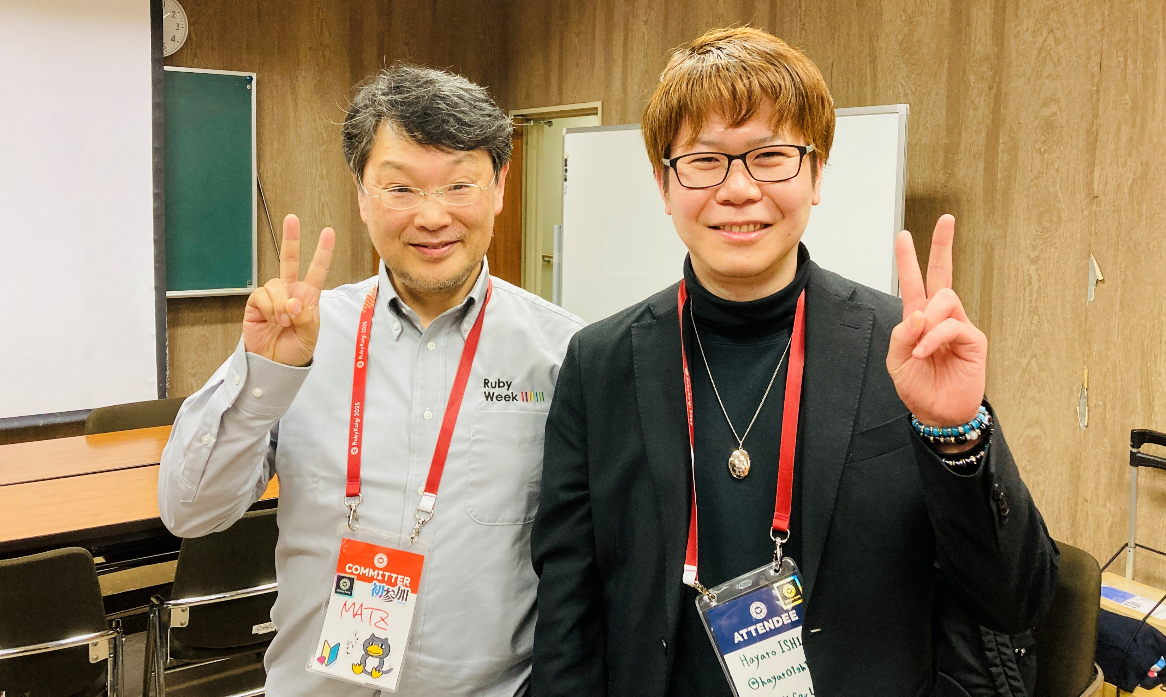
3. The Most Memorable Discussion Mr. Matz
This discussion with Mr. Matz lasted only for 10 minutes or more, but I was honoured to have such a fruitful time.
I cannot be more grateful to Mr. Matz as a big fan of Ruby and linguistics.

Slide 32
4. As Is vs. To Be

Slide 33
4. As Is vs. To Be
AsIs
A Rubyist who implements web applications and scripts in Ruby
ToBe
A Rubyist who knows ecosystems and lifecycles of lower layers of Ruby and optimise performance in web applications and scripts I implement
A Rubyist who understands how Ruby language processing works and commits enhancements
A Rubyist who enriches and optimises linguistic and cognitive design of Ruby

Slide 34
5. References

Slide 35
5. References
RubyKaigi 2025 > Schedule
Last Accessed On: 05 May 2025
LLVM Language Reference Manual
Last Accessed On: 05 May 2025
PARCING TECHNIQUES -A Practical Guide-
Last Accessed On: 05 May 2025
低レイヤを知りたい人のための C コンパイラ作成入門
Last Accessed On: 05 May 2025
MIPS アーキテクチャ
Last Accessed On: 05 May 2025

Slide 36
5. References
うさぎでもわかる計算機システム Part10 コンパイラの基礎・分割コンパイルの流れ
Last Accessed On: 05 May 2025
うさぎでもわかる計算機システム Part11コンパイラの処理の流れ(字句解析と意味解析のしくみ)
Last Accessed On: 05 May 2025
Ruby Parser 開発日誌(14) - LR parser 完全に理解した
Last Accessed On: 05 May 2025
オートマトンと言語理論 学習記 #1: オートマトンとは何か -
Last Accessed On: 05 May 2025
オートマトンと言語理論 学習記 #2: 有限オートマトン -
Last Accessed On: 05 May 2025

Slide 37
5. References
Ruby の中身の予備知識 RubyKaigi の前に知り鯛！
Last Accessed On: 05 May 2025
たのしい Ruby の構文解析ツアー
Last Accessed On: 05 May 2025
LL 法と LR 法の違いは？調べてみた！-完全版-/Comparing LL and LR parse algorithm -EX Edition-
Last Accessed On: 05 May 2025
9cc
Last Accessed On: 05 May 2025
lr-parser-101
Last Accessed On: 05 May 2025

Slide 38
5. References
Yusuke Endo, Ruby でつくる Ruby ゼロから学びなおすプログラミング言語入門, Tokyo, 2017
APIdoc > Ruby
Last Accessed On: 05 May 2025
Perl 6 Design Philosophy
Last Accessed On: 05 May 2025
97 Things Every Programmer Should Know
Last Accessed On: 05 May 2025
プログラマが知るべき97のこと
Last Accessed On: 05 May 2025

Slide 39
EOD

